Slide 1
What is Data Science and What can it offer?
Professor Jennifer Brown
School of Mathematics and Statistics

Slide 2
Overview
How did we get to where we are?
Big data
Data science examples
Data visualization
Where do we go now?

Slide 3
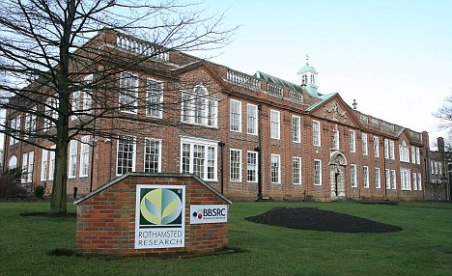
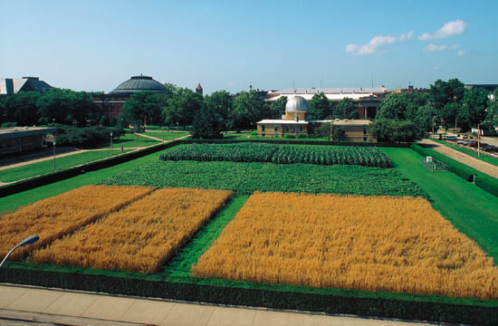
Statistics

Slide 4
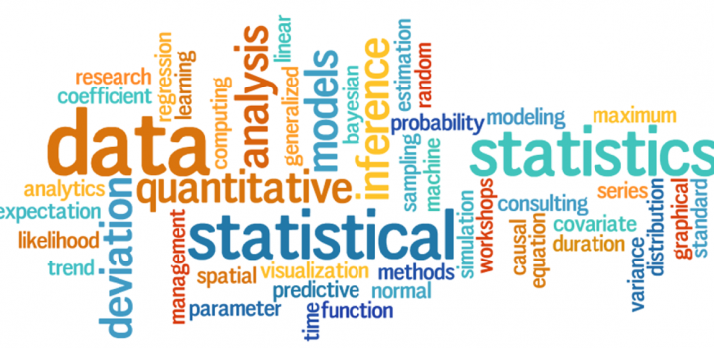
Statistics
The science of data
Data collection
Statistical modelling
Predictions

Slide 5
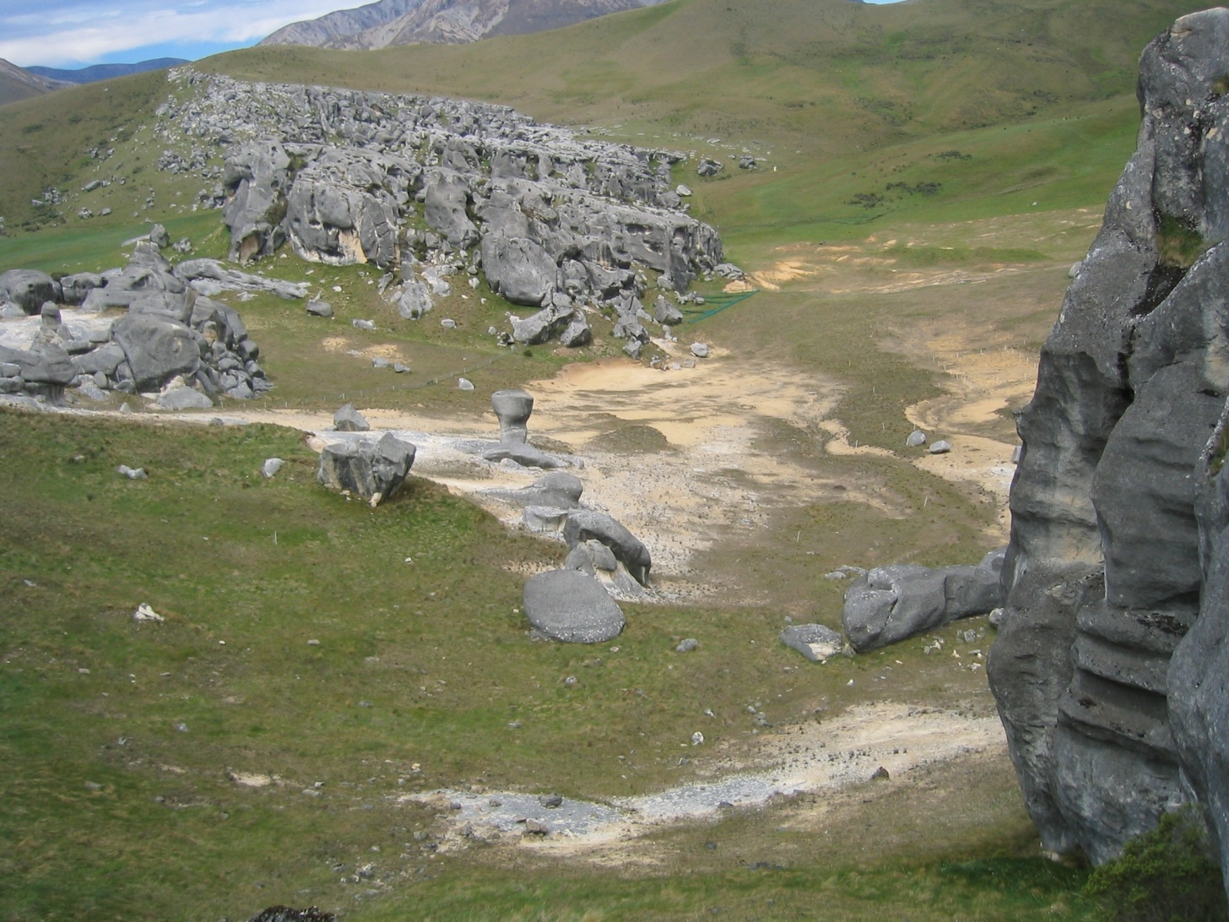
Statistics
Selecting how to sample
Selecting where to sample

Slide 6
Data Science
The NEW science of data

Slide 7
Data Science
“….data is growing at a rate of 2.5 quintillion bytes every day in the US alone.”

Slide 8
Data Science
Every thing we do is measured, mapped, and recorded
Air and water quality
Social media
Shopping
Health
Sensors in industry

Slide 9
Statistics vs Data Science
In statistics, data usually comes from:
Sampling
Experimental Design
Nowadays we also have found data.
Tends to be big and relatively cheap to collect, but messy and unstructured.

Slide 10
Big Data
The “first” documented use of the term big data:
“... data sets are generally quite large, taxing the capacities of main memory, local disk, and even remote disk. We call this the problem of big data.”
1997 paper written by NASA scientists.

Slide 11
Big Data
Volume: the magnitude of data
Variety: different data types and sources
Velocity: the speed at which data is generated
Volume
Velocity
Variety
BIG DATA

Slide 12
Big Data
Volume: the magnitude of data.
2.5 exabytes of data was generated every day in 2012 (IBM)
The engines on a Boeing 787 could generate half a terabyte of data (used for predictive maintenance) in one flight
Square Kilometre Array Radio Telescope will generate 14 exabytes of data per day
Facebook stored 260 billion photos using storage space of 20 petabytes in 2010

Slide 13
Big data
Some numbers that are commonly used in big data.
1000 kilobyte 1,000
1000² megabyte 1,000,000
1000³ gigabyte 1,000,000,000
1000⁴ terabyte 1,000,000,000,000
1000⁵ petabyte 1,000,000,000,000,000
1000⁶ exabyte 1,000,000,000,000,000,000
1000⁷ zettabyte 1,000,000,000,000,000,000,000

Slide 14
Big Data
Variety: the structural heterogeneity in a data set.
Structured
Unstructured: audio, texts, images, clicks etc.
Velocity: the rate at which data are being generated.
Walmart can process one
million transactions per hour
Facebook processes one
million photos per second

Slide 15
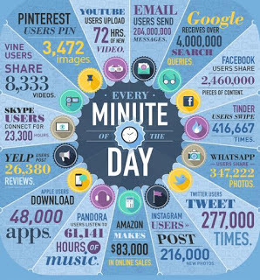
What is happening on the internet?

Slide 16
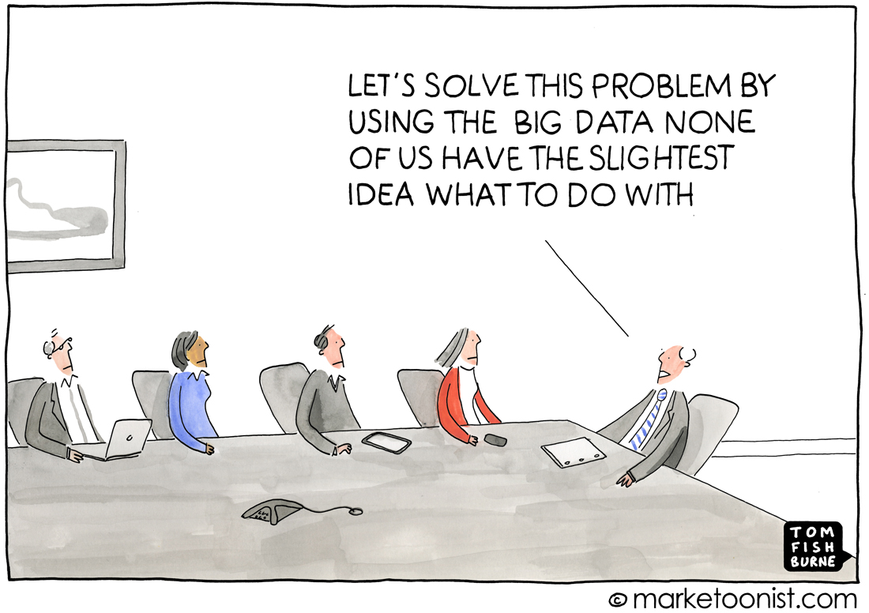
Big Data

Slide 17
Data Science
Data Mining, Machine Learning, Statistical Learning...
Learning from big data is interdisciplinary task
Statistics
Computer Science
Domain knowledge
Knowledge discovery

Slide 18
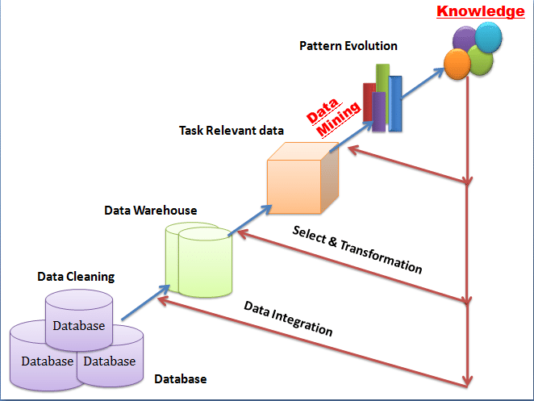
Data Science
Knowledge discovery

Slide 19
Data Science
Data science is about exploring the data, making sense of it in a meaningful way…
…and then applying what is learnt.
(Jennifer Brown 2019)

Slide 20
Road signs

Slide 21
Road signs

Slide 22
Road signs

Slide 23
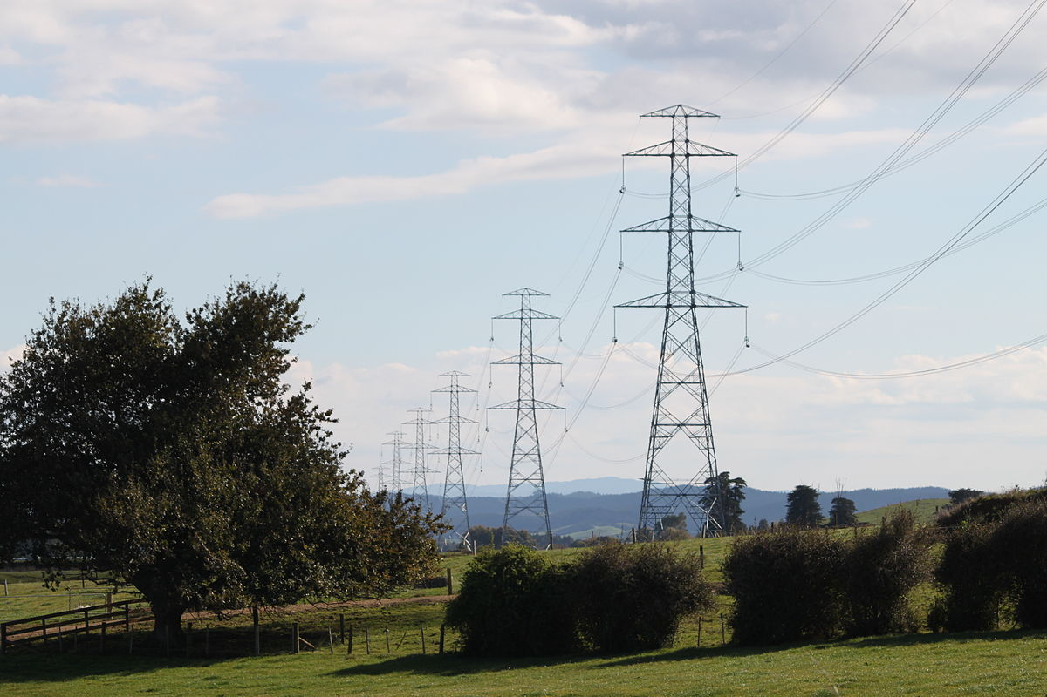
Work Order Priority
Transmission lines in New Zealand
Tens of thousands of open maintenance work orders and limited resources
Which will result in sudden and major asset failure?
Which are lower risk?

Slide 24
Work Order Priority
Predict the asset, component, and risk keyword described in the free text field
Predict likelihood of failure

Slide 25
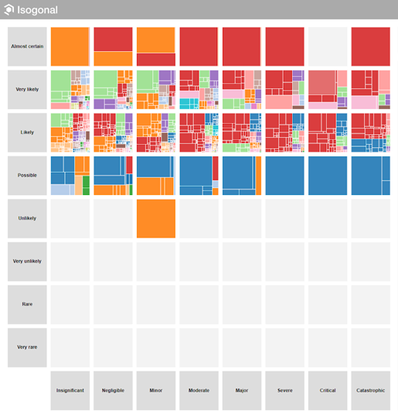
Work Order Priority

Slide 26
The Ageing Populations
500,000 assessments since 2012 of people 65+
Standardised questionnaire
Insights from the data
Social isolation
Frailty scores
Hearing loss

Slide 27
The Ageing Populations
Does hearing loss cause entry into residential care?
Many confounding factors
With a large data set it was possible to tease out the relationship even with 25 confounding factors
No link despite published papers saying the opposite

Slide 28
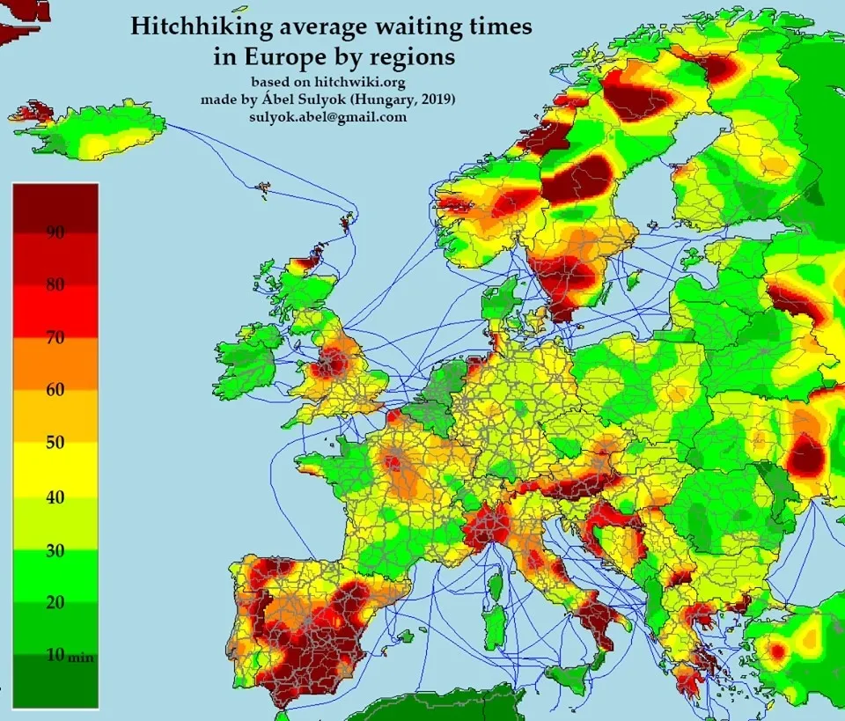
Data Visualisation Hitchhikers guide?

Slide 29
Data Visualisation Who likes beer?

Slide 30
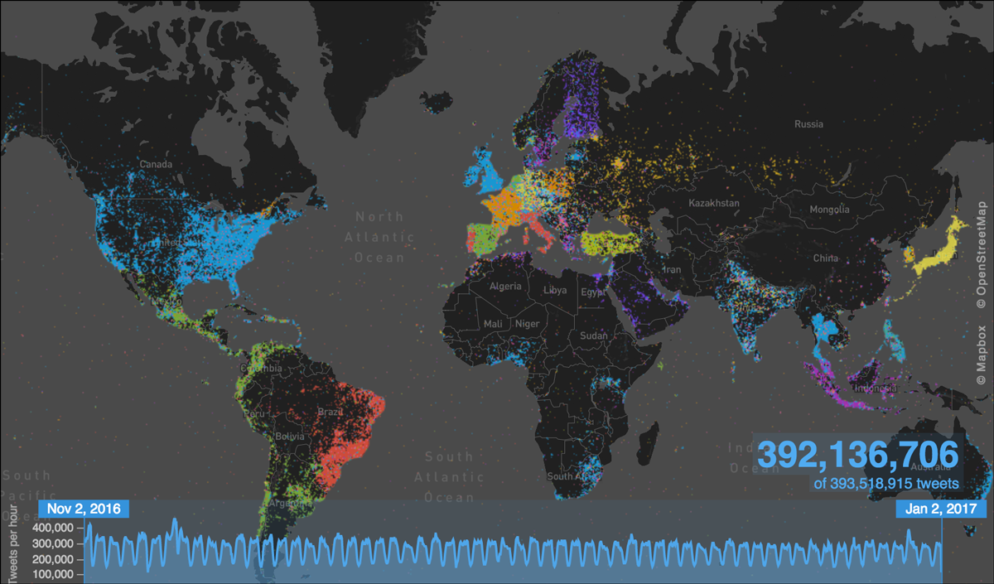
Data Visualisation Tweet map

Slide 31
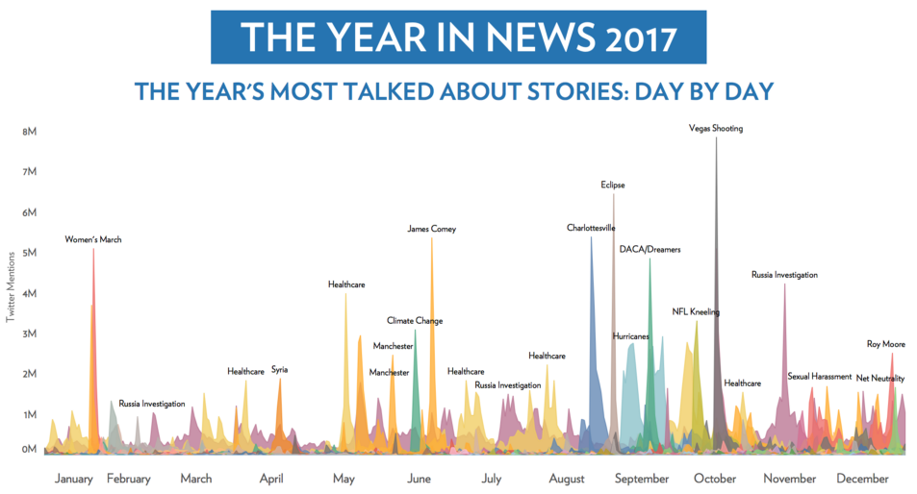
Data Visualisation 2.8 billion tweets in usa

Slide 32
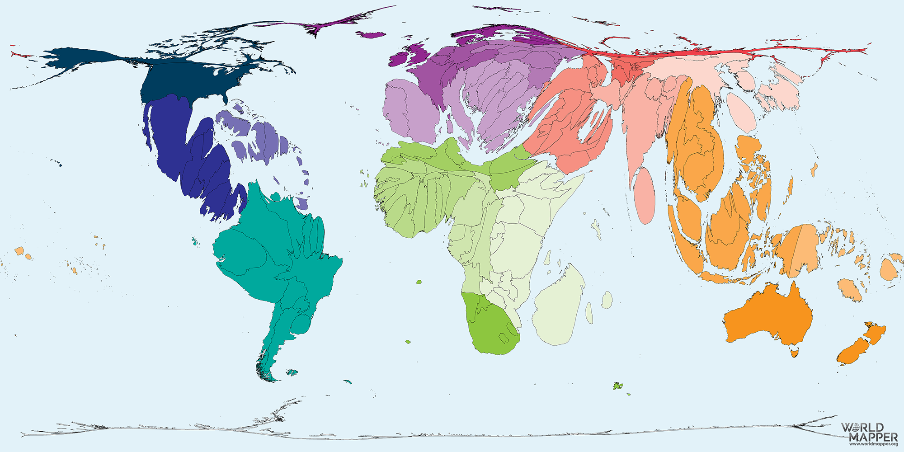
Worldmapper by animal species endangered

Slide 33
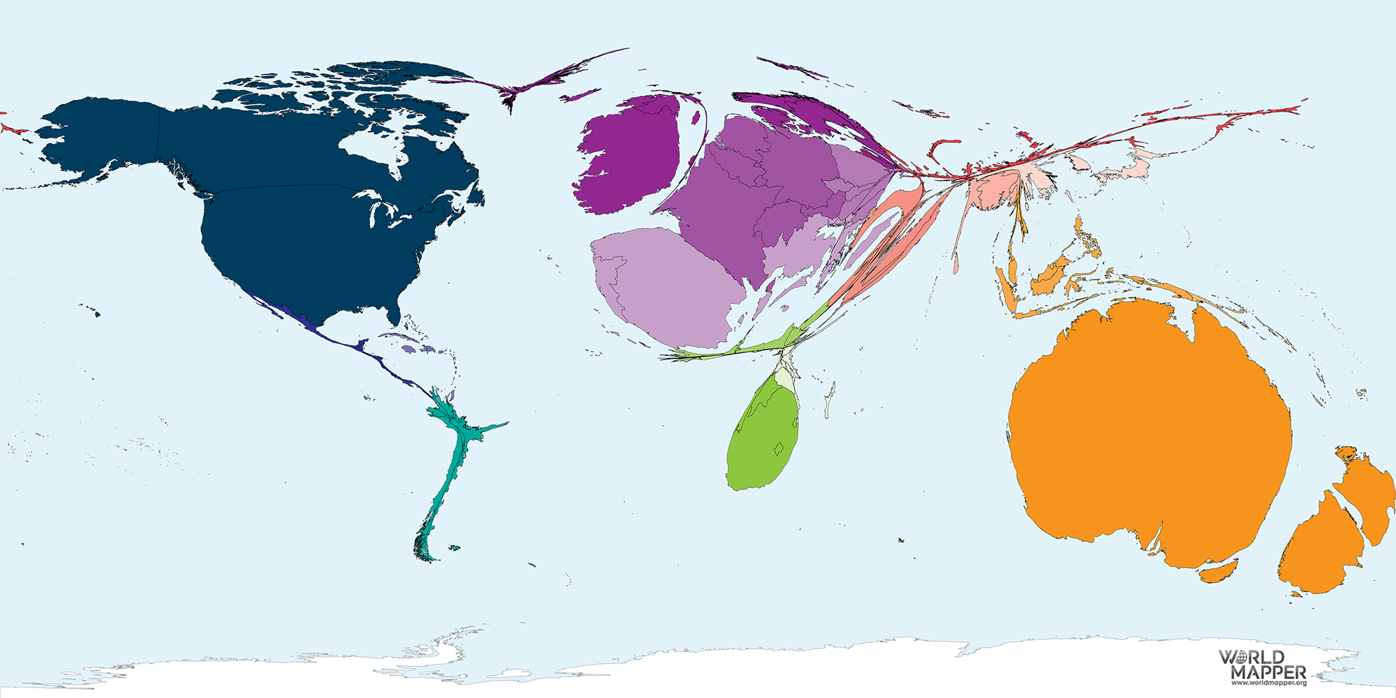
Worldmapper by migration from uk

Slide 34
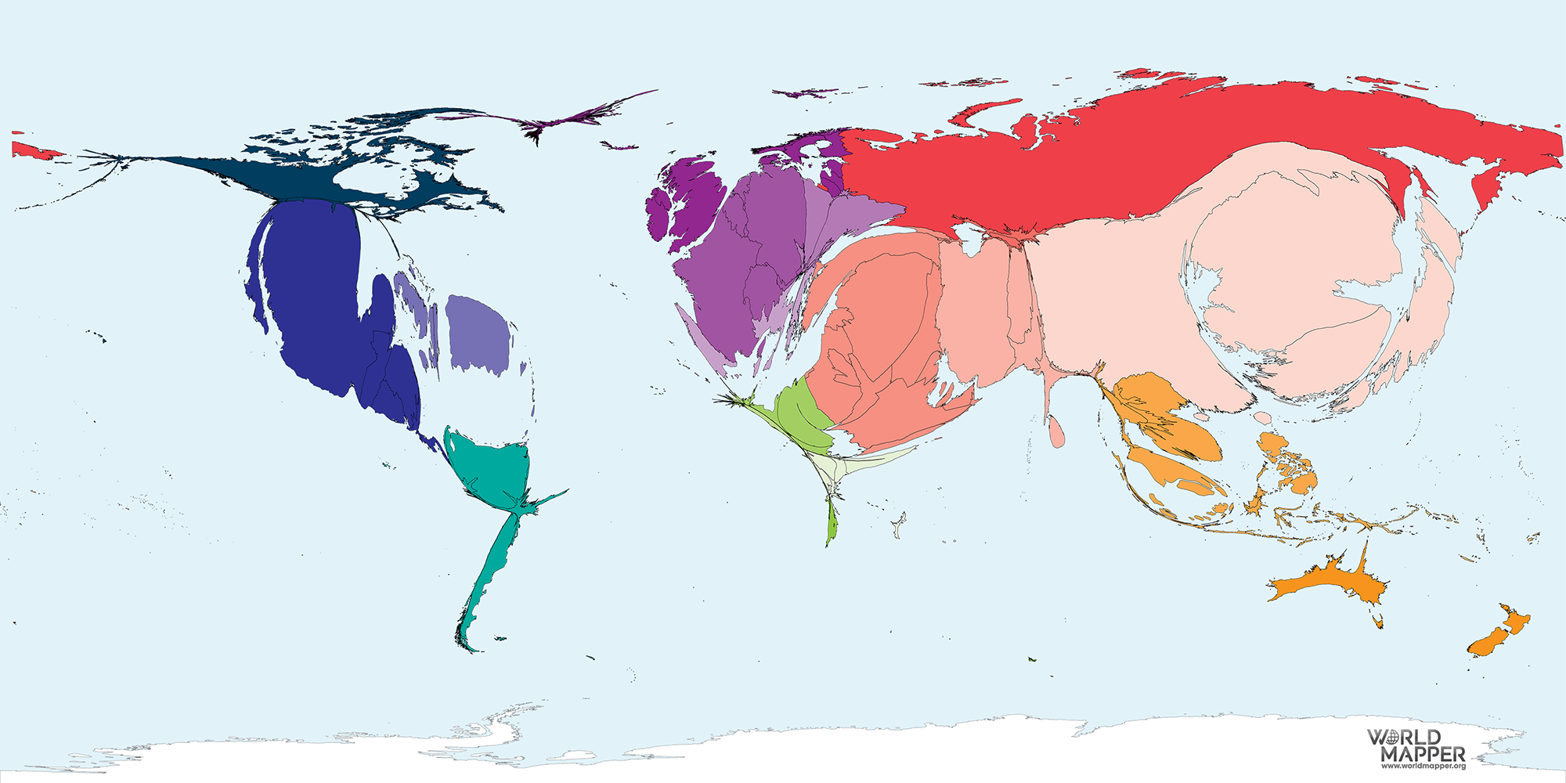
Worldmapper by Donald trumps tweets

Slide 35
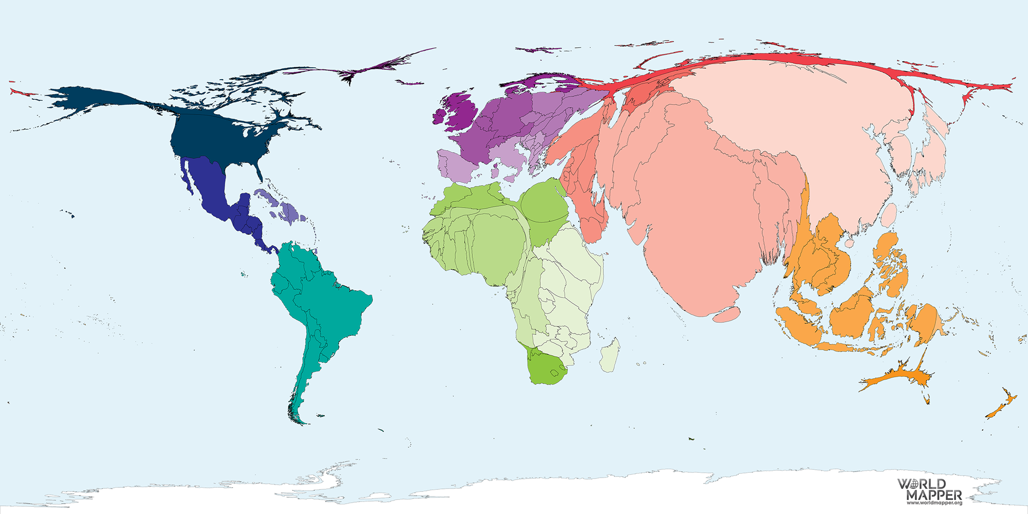
Worldmapper by Population

Slide 36
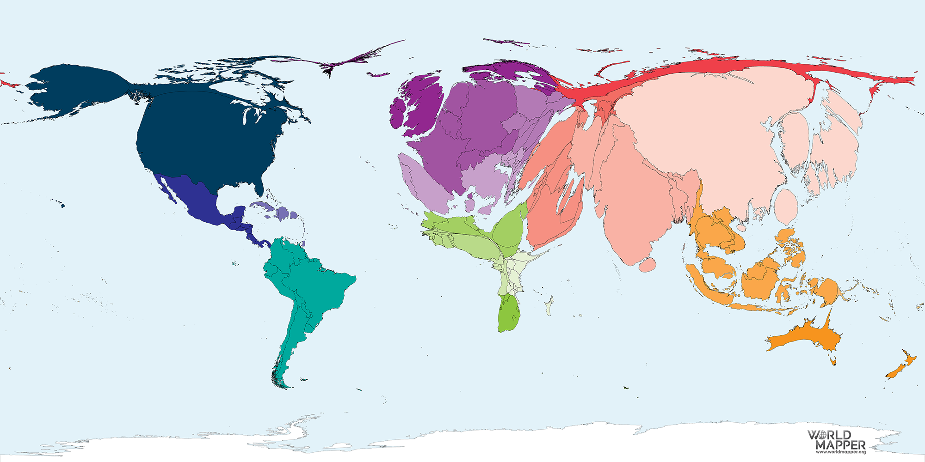
Worldmapper by gdp

Slide 37
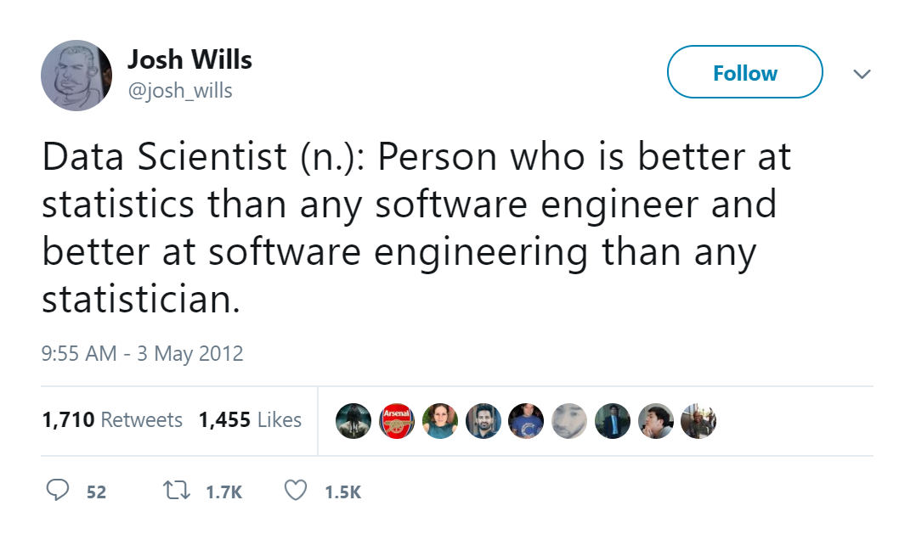
What is a Data Scientist?

Slide 38
What is a Data Scientist?
Things to know before starting as a data scientist:
Data science is a vague term
Imposter syndrome is normal
You’ll never need to know all the tools
Learn the basics well
Be an expert in a domain and the methods
The most important skill is critical thinking
Practice communication

Slide 39
Data Science

Slide 40
Data Science
Society is changing.
How are we responding?

Slide 41
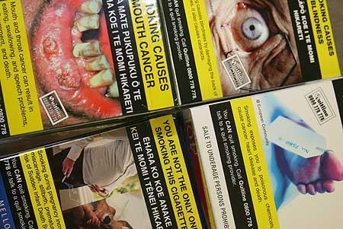
Statistics & social change
Smoking and cancer

Slide 42
Data Science & social change
What will your world look like?

Slide 43
A better world
Thank you

